Slide 1
What is the continuous delivery pipeline?
The continuous delivery pipeline (or CI/CD pipeline) forms the backbone of modern DevOps. It refers to a process in which certain key steps in the software delivery process are automated. The ultimate goal is to speed things up and reduce errors.
It takes its bearings from other agile software development best practices, including build automation, version control, and automated deployments. Projects progress in small iterations and feedback (from other developers, teams, and stakeholders) is continual.
Continuous integration is the first stage, followed by continuous delivery and then, finally, continuous deployment. Together, these make up the pipeline.

Slide 2
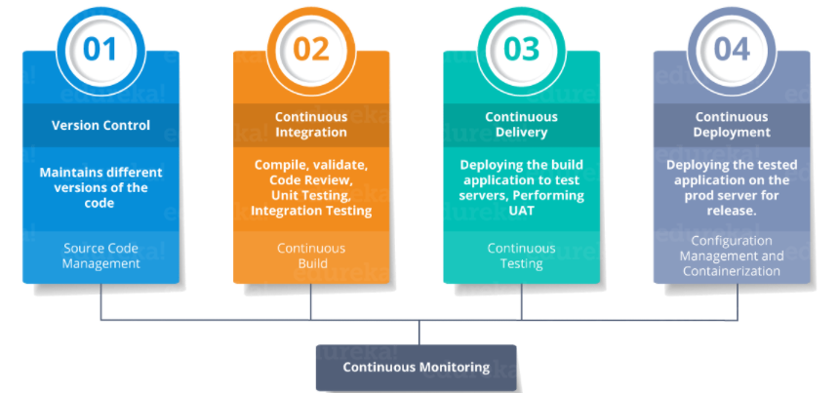

Slide 3
CD pipeline & Bottlenecks :
Continuous delivery is a software development process in which developers commit code and merge it into the main branch with consistency to make the product software-ready at any given moment in time.
Now, you do a lot of planning and strategy before approaching any project. Likewise, a CD pipeline is one end-to-end strategy that defines how the software development should take place going through various stages.
Usually, the CD pipeline consists of these following stages

Slide 4
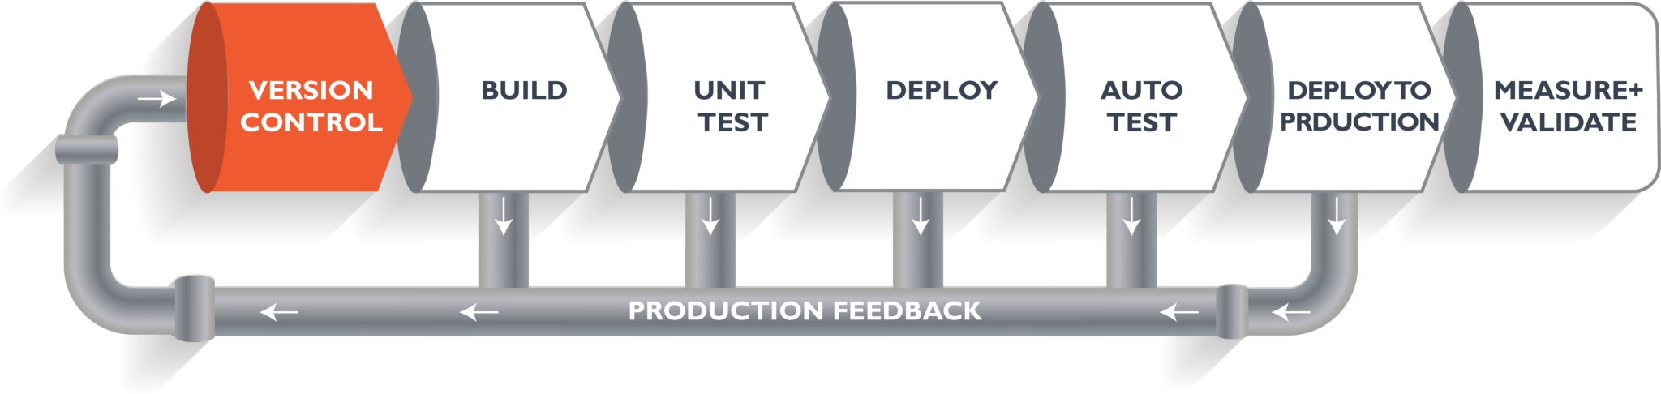
The above pipeline is a logical demonstration of how software will move along the various stages in this lifecycle before it is delivered to the customer or before it is live in production.
Let's take a scenario of a CI/CD Pipeline. Imagine you're going to build a web application which is going to be deployed on live web servers. You will have a set of developers responsible for writing the code, who will further go on and build the web application. Now, when this code is committed into a version control system (such as git, svn) by the team of developers. Next, it goes through the build phase, which is the first phase of the pipeline, where developers put in their code and then again the code goes to the version control system with a proper version tag.

Slide 5
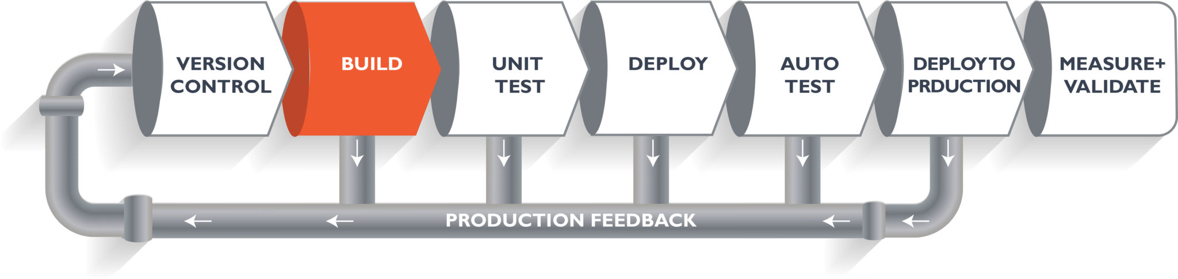
Suppose we have Java code and it needs to be compiled before execution. Through the version control phase, it again goes to the build phase, where it is compiled. You get all the features of that code from various branches of the repository, which merge them and finally use a compiler to compile it. This whole process is called the build phase.

Slide 6
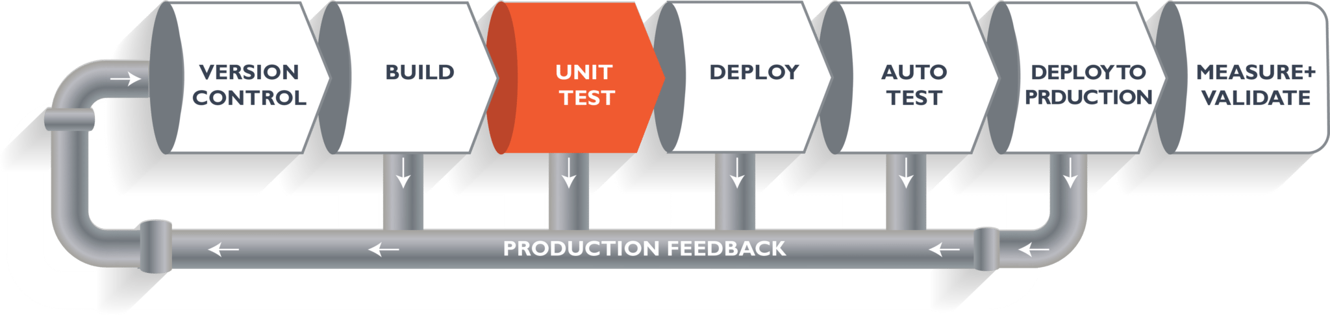
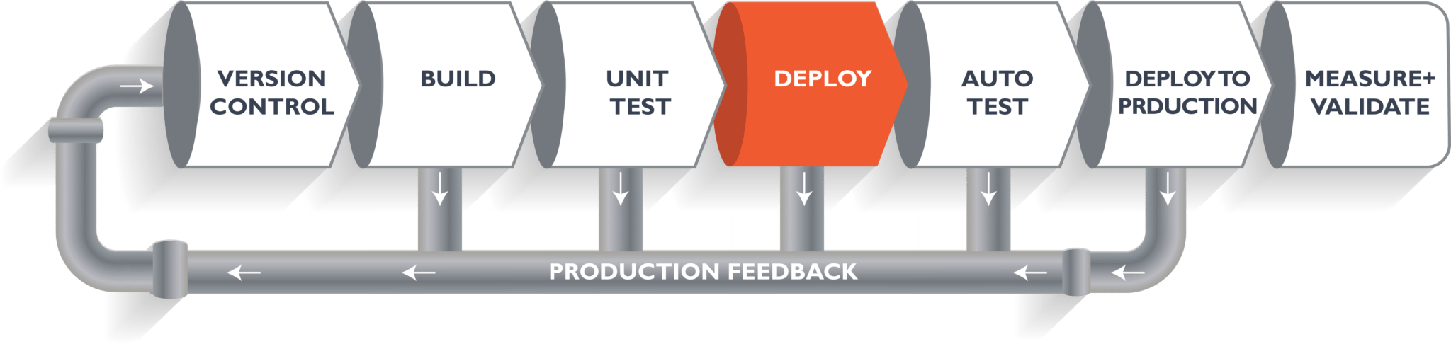
Once the build phase is over, then you move on to the testing phase. In this phase, we have various kinds of testing. One of them is the unit test (where you test the chunk/unit of software or for its sanity test).

Slide 7
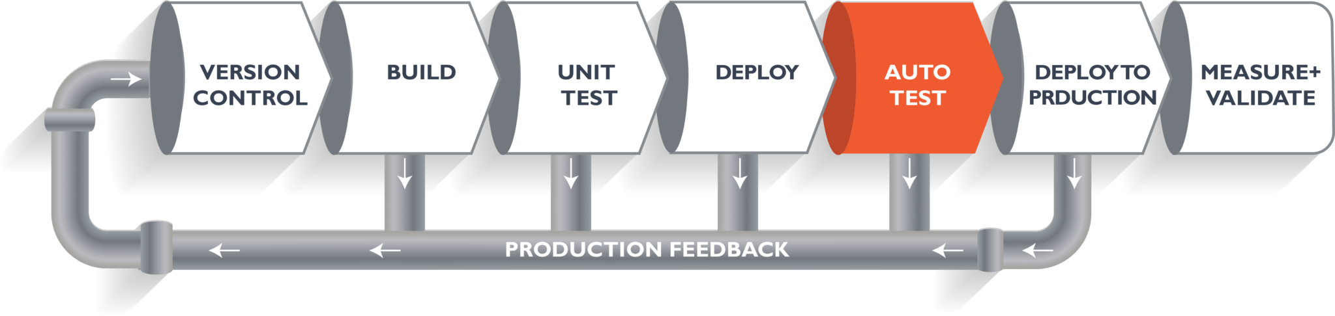
When the test is completed, you move on to the deploy phase, where you deploy it into a staging or a test server. Here, you can view the code or you can view the app in a simulator.

Slide 8
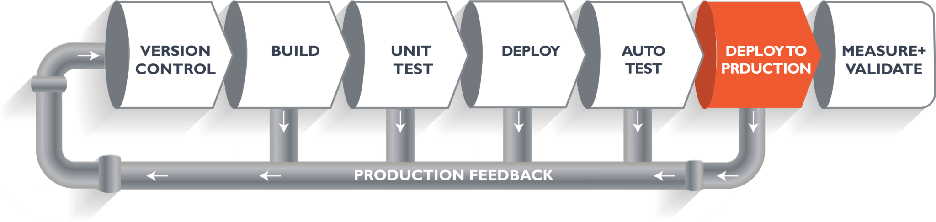
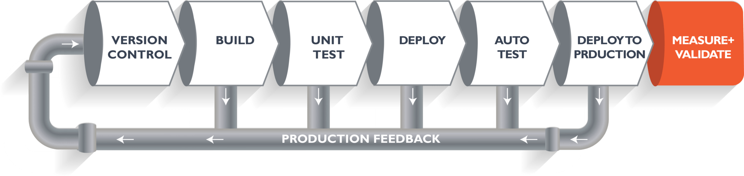
Meanwhile, in every step, if there is an error, you can shoot an email back to the development team so that they can fix it. Then they will push it into the version control system and it goes back into the pipeline.

Slide 9
The Continuous Delivery Pipeline and the Top Bottlenecks
Continuous Delivery is an appealing approach, allowing rapid application updates, so end users get features and fixes as soon as they’re ready. Developers, for their part, can fix and push updates to address bug reports almost as quickly as they come in.
Inconsistent Environments
In almost every company I have worked for or consulted with, a huge amount of waste exists because the various environments (dev, test, stage, prod) are configured differently. I call this “environment hell”. How many times have you heard a developer say “it worked on my laptop”? As code moves from one environment to the next, software breaks because of the different configurations within each environment. I have seen teams waste days and even weeks fixing bugs that are due to environmental issues and are not due to errors within the code..

Slide 10
2. Time Spent Testing Code
Developers know that applying fixes and updates to code is only the beginning of the process. Devs spend just 30 percent of their time writing the code, and 70 percent of their time reading and testing it. Without the proper debugging tools and automation processes, the amount of time spent on testing can spiral out of control.
Many dev teams have found it helpful to predetermine how much time they will spend testing code to avoid this common problem. Moreover, team confidence in the Continuous Integration server can help with pushing code into production faster.
3. Time Spent Creating Code
Writing the code can be a major bottleneck. This holdup typically stems from a combination of programming inexperience and platform unfamiliarity. It’s common for developers to work on multiple projects that require different programming skills. Problems also stem from poorly organized and documented application code. The best ways to resolve delays in the code creation process include training devs in the necessary languages and platform operations, as well as intelligently organizing, separating, and documenting code.

Slide 11
4. Lack of Testing/Quality Assurance Personnel
Teams also reported that staffing shortages in the testing and QA departments often hold up the process. In many organizations, the same people who write the code are also the ones who do the testing and QA work. Staffing shortages disrupt the assembly line flow of the CD process.
5. Lack of Testing Facilities, Developers, and QA Needing to Wait
The CI and CD processes work best when the development team is using a branching pattern to break off parts of the applications into smaller, more manageable chunks. Failing to do this can prevent QA staff from being able to test code because devs are holding back a feature update while working on other code. Updates can also be delayed because the testing infrastructure is unable to keep up.
6. Lack of Workflow/Automation Tools to Drive the Continuous Delivery Pipeline
Development teams report problems with workflow and automation tools delaying CD. The source of this issue is often a lack of high-quality tools available to help manage testing for constant updates.

Slide 12
7. SDLC Maturity
The maturity of a team’s software development lifecycle (SDLC) has a direct impact on their ability to deliver software. There is nothing new here; SDLC maturity has plagued IT for decades. In the age of DevOps, where we strive to deliver software in shorter increments with a high degree of reliability and quality, it is even more critical for a team to have a mature process.
Some companies I visit are still practicing waterfall methodologies. These companies struggle with DevOps because they don’t have any experience with agile. But not all companies that practice agile do it well. Some are early in their agile journey, while others have implemented what I call “Wagile”: waterfall tendencies with agile terminology sprinkled in. I have seen teams who have implemented Kanban but struggle with the prioritization and control of WIP. I have seen scrum teams struggle to complete the story points that they promised. It takes time to get really good at agile.
8. Legacy Change Management Processes
Many companies have had their change management processes in place for years and are comfortable with it. The problem is that these processes were created back when companies were deploying and updating back office solutions or infrastructure changes that happened infrequently.
Fast forward to today’s environments where applications are made of many small components or micro services that can be changed and deployed quickly, now all of a sudden the process gets in the way.

Slide 13
9. Outdated testing practices
Too often I see clients who have a separate QA department that is not fully integrated with the development team. The code is thrown over the wall and then testing begins. Bugs are detected and sent back to developers who then have to quickly fix, build, and redeploy. This process is repeated until there is no time remaining and teams are left to agree on what defects they can tolerate and promote to production. This is a death spiral in action. With every release, they introduce more technical debt into the system lowering its quality and reliability, and increasing unplanned work. There is a better way.
The better way is to block bugs from moving forward in the development process. This is accomplished by building automated test harnesses and by automatically failing the build if any of the tests fail. This is what continuous integration is designed for. Testing must be part of the development process, not a handoff that is performed after development. Developers need to play a bigger part in testing and testers need to play a bigger part in development. This strikes fear in some testers and not all testers can make the transition.
10. Automating waste
A very common pattern I run into is the automation of waste. This occurs when a team declares itself a DevOps team or a person declares themselves a DevOps engineer and immediately starts writing hundreds or thousands of lines of Chef or Puppet scripts to automate their existing processes. The problem is that many of the existing processes are bottlenecks and need to be changed. Automating waste is like pouring concrete around unbalanced support beams. It makes bad design permanent.
Database schema changes.
Test data doesn't match expectations.
Deploys are person dependent, and the person wasn't available.

